Slide 1
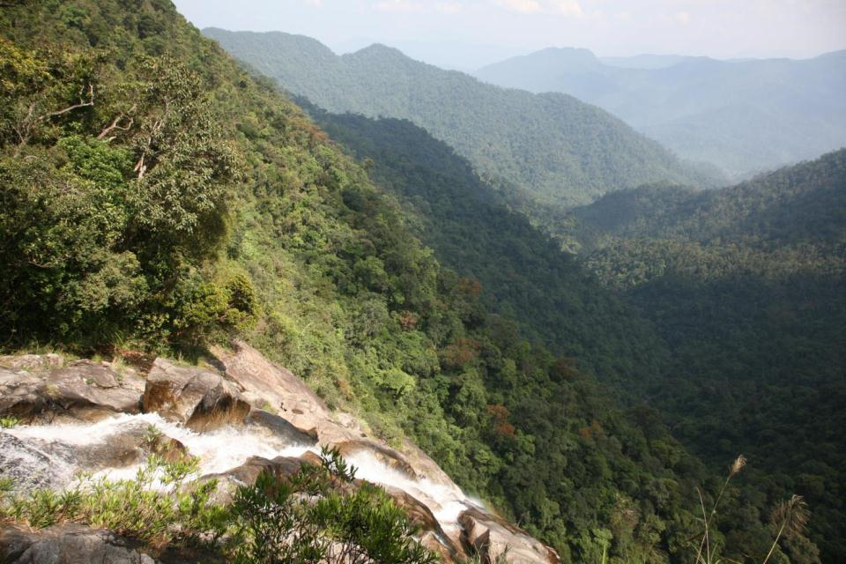
Component 4: Strengthened Institutions and Financing
Activity Progress and Component Strategy

Slide 2
Activity Progress May-Oct 2012
Strengthening Institutions – WGE, NSUs and EOC
EOC Recruitment
EOC most international positions filled, GMS associate positions hiring well advanced, Technical Program Head recruitment under process.
Program Development
Inception report finalized, component strategies developed, concept paper for activities being developed and discussed with relevant stakeholders
NSU operating in Cambodia, Lao PDR and Viet Nam
Knowledge Products and Outreach
Launch of new EOC Website and GMS Interactive Atlas
GMS Atlas 2nd Edition/GMS 2020 Proceedings/CEP-BCI Brochure
Trainings and Knowledge Sharing
SEA capacity development – 7 GMS delegates attended training and shared GMS SEA experience at 12th Annual Conference of the International Association of Impact Assessment (IAIA)
Notes:
Institutions
LoAs with NSUs – Status?
Recruitment – not sure about NSU recruitment?
Program Publications (those that are cross component) GMS Atlas 2nd Edition at the printers/CEP-BCI brochure produced, main print run and translations in national languages to occur once funds/
GMS2020 Proceedings produced, dissemination soon.
Financing
Component strategies developed – (could, if necessary, recap WHY these are important – ie how they complement PFD and workplan etc).
Co-financing – mention likely funds disbursement date, the delay impact, also status of Sida agreeement

Slide 3
Activity Progress May-Oct 2012
Sustainable Financing and Investment
Finland co-financing agreement signed - $14 million
Processing of co-financing agreement with Sida and change of scope to TA
Investment concept paper on low carbon economic corridor prepared
Notes:
Institutions
LoAs with NSUs – Status?
Recruitment – not sure about NSU recruitment?
Program Publications (those that are cross component) GMS Atlas 2nd Edition at the printers/CEP-BCI brochure produced, main print run and translations in national languages to occur once funds/
GMS2020 Proceedings produced, dissemination soon.
Financing
Component strategies developed – (could, if necessary, recap WHY these are important – ie how they complement PFD and workplan etc).
Co-financing – mention likely funds disbursement date, the delay impact, also status of Sida agreeement

Slide 4
Component 4 structure
Strengthening institutions and finance
INSTITUTIONS
1. Building WGE capacity for regional collaboration
2. Establishing NSUs
3. Building EOC as a regional knowledge / capacity building hub
INVESTMENT/ FINANCE
1. Supporting development of sustainable financing mechanisms (REDD+, PES)
2. Development of investment projects and promotion of private sector partnerships
Objectives:
Strengthen roles of WGE and national support units in delivering sub-regional outcomes and impacts;
Strengthen the role of EOC in building technical human capacity in the subregion and as a knowledge hub for environmental management; and
Develop sustainable financing mechanisms and facilitate public-private-partnerships for ecosystem management
Notes:
Depending on time available, and if some of the audience require, can give some examples of work under the three objectives

Slide 5
Results-based planning
2016
NSUs fully operational in at least four countries
At least 50% of EOC professional staff are from GMS, at least 40% of them women
At least two bankable private sector projects in environment and natural resources developed and collaboration secured
Guidelines supporting sustainable financing mechanisms developed in at least two countries
2013
2014
2015
WGE
Areas of collaboration identified with other sectors
Joint program framework developed with 2 sectors
Progress and future directions supported by EMM
WGE continues to provide technical direction for program implementation
Joint projects implemented with other sectors At least two projects successfully piloted with other sector groups
NSU
Structure, function and capacity needs identified for NSUs
NSU strategy in place
NSUs sufficiently resourced to implement program
At least 10% of national activity funds managed by NSU
NSUs sufficiently resourced to implement CEP-BCI Phase II
EOC
Technical capacity of EOC to support WGE in place
EOC positions filled; Regular progress updates and reporting
Increased demand for CEP-BCI expertise and knowledge
Online library receives 50 downloads / month & grows by 1 publication / month
‘University network’ with planners and decision makers established
Financing
Areas for collaboration with private sector developed Private sector partners engaged in 2 activities
Areas for potential investment identified
3 investment frameworks prepared
Further funding to support GMS countries leveraged
2 new sources of funding secured

Slide 6
Priority Activities
Signing of LoA for establishment of NSUs/ PSUs with following functions
Establishment / strengthening of NSU and institutional needs assessment for program implementation
Coordination, monitoring, reporting and outreach support for CEP-BCI Phase 2 activities.
Support to development and maintenance of Environmental Information System (EIS)
Complete EOC and NSU recruitment
Begin institutional needs assessment
Finalize co-financing agreement with Sida

